Slide 1
Machine learning
Brian Caffo, Jeff Leek, Roger Peng
@bcaffo
www.bcaffo.com

Slide 2
Machine learning is a set of algorithms that can take a set of inputs (data) and return a prediction

Slide 3
Non-exhaustive list of ML activities:
Unsupervised learning
Supervised learning

Slide 4
Unsupervised learning: trying to uncover unobserved factors; clustering, mixture models, principal components

Slide 5
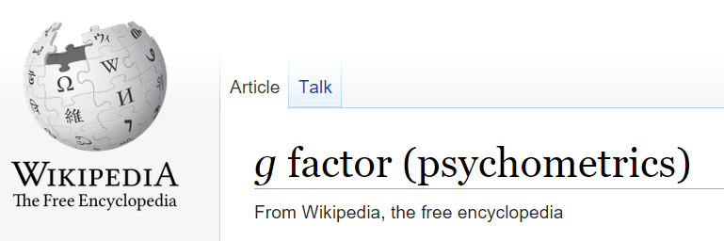

Slide 6
Supervised learning: using a collection of predictors and some observed outcomes to build an algorithm to predict the outcome when it is not observed; random forests, boosting, SVMs

Slide 7
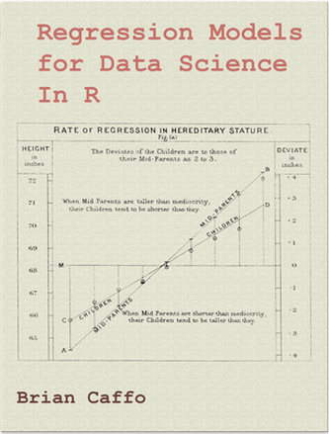

Slide 8
Contrasting machine learning and traditional statistical analyses
Machine learning
Emphasize predictions
Evaluates results via prediction performance
Concern for overfitting but not model complexity per se
Emphasis on performance
Generalizability is obtained through performance on novel datasets
Usually no superpopulation model specified
Concern over performance and robustness
Traditional statistical analyses
Emphasizes superpopulation inference
Focuses on a-priori hypotheses
Simpler models preferred over complex ones (parsimony), even if the more complex models perform slightly better
Emphasis on parameter interpretability
Statistical modeling or sampling assumptions connects data to a population of interest
Concern over assumptions and robustness

Slide 9

Examples
Machine learning
build an automated movie recommender system
success - anything that produces reliable recommendations
Statistical analysis
build a parsimonious and interpretable model to better understand why people choose the movies that they do
success - anything true learned about movie choices

Slide 10
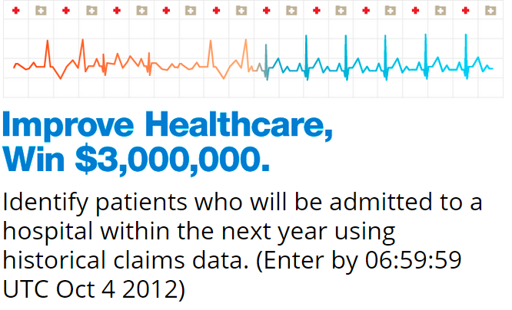
Examples
Machine learning
build an automated system for predicting hospital stays from previous claims
success - anything that produces reliable predictions
Statistical analysis
build a parsimonious and interpretable model to better understand why people stay in the hospital longer
success - anything true learned about hospital stays

Slide 11
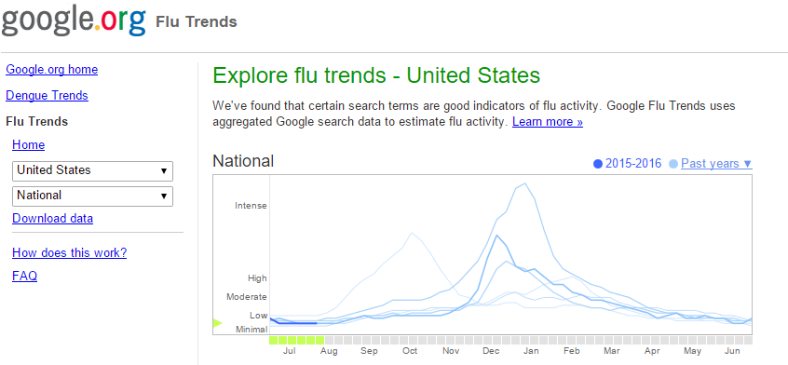
Google flu trends
Machine learning
build an automated system for predicting flu outbreaks
success - anything that produces reliable predictions
Statistical analysis
build a parsimonious and interpretable model to better understand flu outbreaks
success - anything true learned about the flu

Slide 12
Lessons learned
Both approaches are extremely valuable and have their place
Amount of tolerable model/algorithm complexity changes dramatically between the approaches
Goals of the approaches are very different
Caveat - there’s a fair amount of work on making machine learning algorithms more interpretable and work on producing better predictions from more traditional approaches
(Meeting in the middle?)

Slide 13
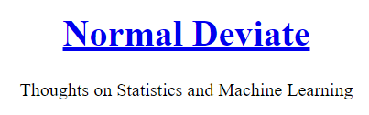
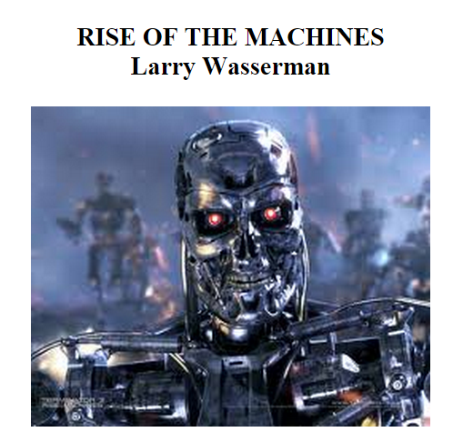

Slide 14
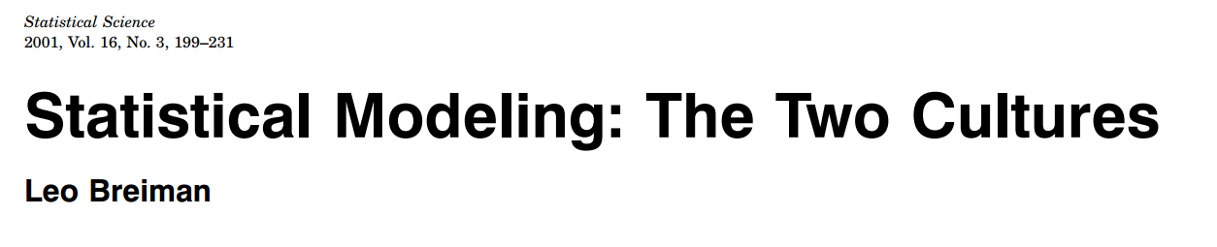
Further reading
“In this paper I will argue that the focus in the statistical community on data models has:
Led to irrelevant theory and questionable scientific conclusions;
Kept statisticians from using more suitable algorithmic models;
Prevented statisticians from working on exciting new problems;”

Slide 15
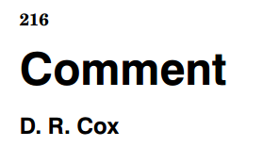
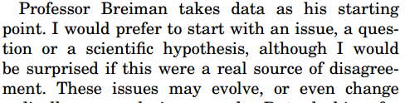
Further reading

Slide 16

Further reading
“so that the apparent superiority of more sophisticated methods may be something of an illusion. In particular, simple methods typically yield performance almost as good as more sophisticated methods, to the extent that the difference in performance may be swamped by other sources of uncertainty that generally are not considered in the classical supervised classification paradigm.”

